Slide 1
L E C T U R E
5
Project Management Concepts
Notes:
This repository of slides is intended to support the named chapter. The slide repository should be used as follows:
Copy the file to a unique name for your course and unit.
Edit the file by deleting those slides you don’t want to cover, editing other slides as appropriate to your course, and adding slides as desired.
Print the slides to produce transparency masters or print directly to film or present the slides using a computer image projector.
Each slide includes instructor notes. To view those notes in PowerPoint, click-left on the View Menu; then click left on Notes View sub-menu. You may need to scroll down to see the instructor notes.
The instructor notes are also available in hardcopy as the Instructor Guide to Accompany Systems Analysis and Design Methods, 5/ed.

Slide 2
PROJECT MANAGEMENT CONCEPTS
Recap
What is it?
Who does it?
Why is it important?
What are the steps?
Understand the four P’s—people,
product, process, and project.
What is the work product?
How do I ensure that I’ve done it right?

Slide 3
Coordination and Communication Issues
How do we coordinate the actions of team members?
Include group meetings for information dissemination and problem solving and “collocation of requirements and development staff”
Kraul and Streeter[KRA95]
Encompasses electronic mail,electronic bulletin boards, and by extension, video-based conferencing systems.
Formal, impersonal approaches
Formal, interpersonal procedures
Informal, interpersonal procedures
Electronic communication
Interpersonal networking
Includes informal discussions with team members and those outside the project who may have experience or insight that can assist team members
Include software engineering documents and deliverables, technical memos, project milestones, schedules, and project control tools, change requests and related documenttation, error tracking reports, and repository data.
Focus on quality assurance activities applied to software engineering work products. These include status review meetings and design and code inspections

Slide 4
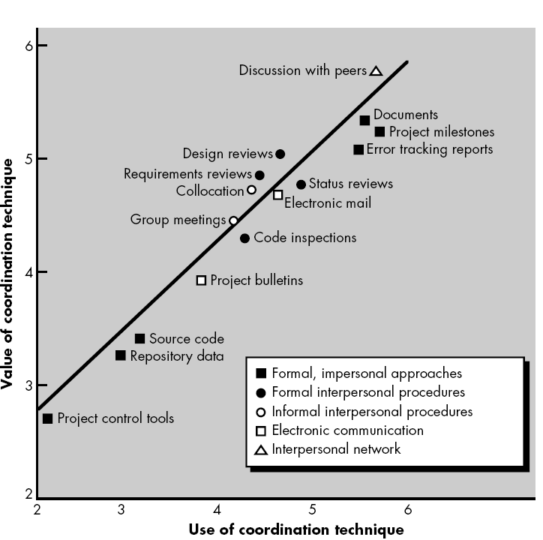

Slide 5
THE PRODUCT
we must examine the product and the problem it is intended to solve at the very beginning of the project.
At a minimum, the scope of the product must be
established and bounded.

Slide 6
Software Scope
The first software project management activity is the determination of software scope.
Scope is defined by answering the following questions:
Context. How does the software to be built fit into a larger system, product, or business context and what constraints are imposed as a result of the context?
Information objectives. What customer-visible data objects are
produced as output from the software? What data objects are required for input?
Function and performance. What function does the software perform to
transform input data into output? Are any special performance characteristics
to be addressed?

Slide 7
THE PROCESS
The generic phases that characterize the software process—definition, development, and support—are applicable to all software. The problem is to select the process model that is appropriate for the software to be engineered by a project team.
the linear sequential model
• the prototyping model
• the RAD model
• the incremental model
• the spiral model
• the WINWIN spiral model
• the component-based development model
• the concurrent development model
• the formal methods model
• the fourth generation techniques model

Slide 8
THE PROCESS
The project manager must decide which process model is most appropriate for
(1) the customers who have requested the product and the people who will do the work,
(2) the characteristics of the product itself, and
(3) the project environment in which the software team works.
When a process model has been selected, the team then defines a preliminary project plan based on the set of common process framework activities. Once the preliminary plan is established, process decomposition begins. That is, a complete plan, reflecting the work tasks required to populate the framework activities must be created.

Slide 9
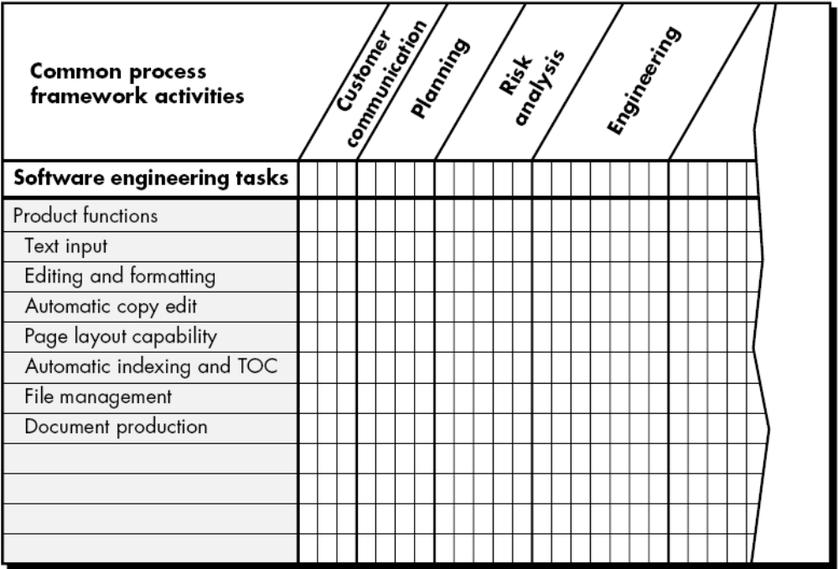
FIGURE : Melding the Problem and the Process

Slide 10
THE PROJECT
John Reel [REE99] defines ten signs that indicate that an information systems project is in jeopardy:
1. Software people don’t understand their customer’s needs.
2. The product scope is poorly defined.
3. Changes are managed poorly.
4. The chosen technology changes.
5. Business needs change [or are ill-defined].
6. Deadlines are unrealistic.
7. Users are resistant.
8. Sponsorship is lost [or was never properly obtained].
9. The project team lacks people with appropriate skills.
10. Managers [and practitioners] avoid best practices and lessons learned.

Slide 11
How does a manager act to avoid the problems just noted?
Reel [REE99] suggests a five-part commonsense approach to software projects:
Start on the right foot.
Maintain momentum.
Track progress.
Make smart decisions.
Conduct a postmortem analysis.

Slide 12
THE W5HH PRINCIPLE
What questions need to be answered in order to develop a project plan?
Why is the system being developed?
What will be done, by when?
Who is responsible for a function?
Where are they organizationally located?
How will the job be done technically and managerially?
How much of each resource is needed?

